Slide 1
Discounts

Slide 2
Table Of Content
Discount before tax
Discount after tax
Comparison of Discount Before Tax And After Tax
Account-wise discount
Buy n x Get m Y
FOC-Discount
FOC-Quantity
NET-Discount
GROSS-Discount

Slide 3
Types Of Discounts
Discount before tax
Discount after tax
Account-wise discount
Buy n X Get m Y
FOC-Discount
FOC-Quantity
NET-Discount
GROSS-Discount

Slide 4
Discount Before Tax
Discount are subtracted from the amount before including tax
Tax are calculated from amount that discount subtracted from it.
Tax = (amount – Discount) * tax percent/100
Eg : Tax= (20,000-500) * 12/100 = 2,340
quantity | rate | amount | discount | tax | amount
2 | 10,000.00 | 20,000.00 | 500.00 | 2,340.00 | 21,840.00

Slide 5
Discount After Tax
Discount are subtracting from amount after adding the Tax
Tax = amount * tax percent/100
Eg : Tax = 20,000 * 12/100 = 2400
quantity | rate | amount | tax | discount | amount
2 | 10,000.00 | 20,000.00 | 2,400.00 | 500 | 21,900.00

Slide 6
Comparison Between Discount Before Tax And Discount After Tax
Discount Before Tax
Discount After Tax
After calculating the total amount of the items, subtract discount from the total and we add the tax, then provide the grand total
Tax= (20,000-500) * 12/100 = 2,340
It provides less tax amount when compared to discount after tax
After calculating the amount of the items, we add tax to the total and subtract the discount, then provides the grand total
Tax = 20000 * 12/100 = 2400
It has more tax amount than discount before tax

Slide 7
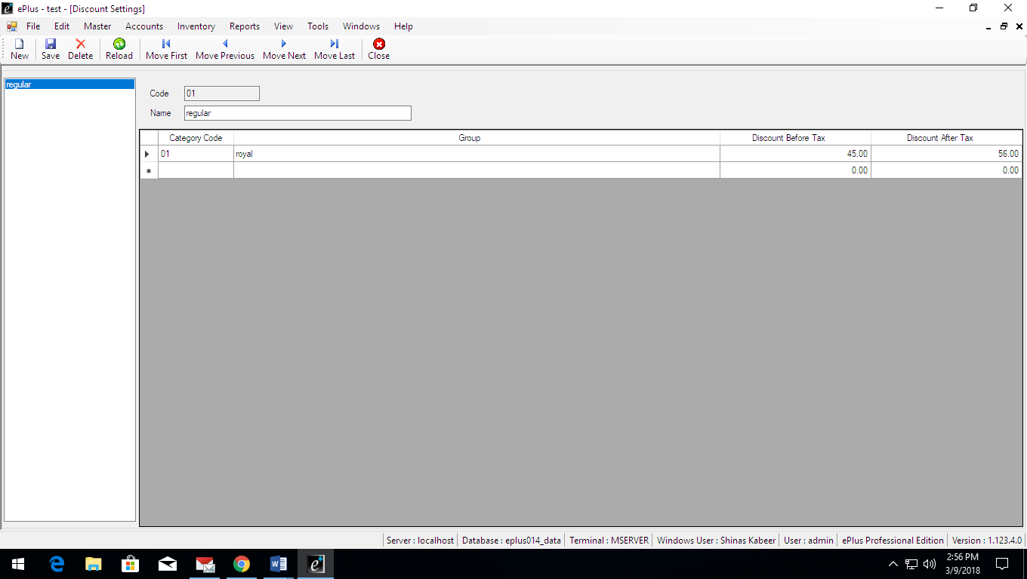
Account-Wise Discount
It helps to provide different discounts to different customers
Adding customers to different discount groups
We can set discount before tax and discount after tax in the discount groups

Slide 8
Buy n X Get m Y
Here, if customer buys 3 items, they gets one item for free
Eg : buy 3 get 1
It is a pre-defined offer

Slide 9
FOC-Discount
(FOC-Free of cost)
If customer buys ‘n’ items, then seller provide ‘m’ items for free
Here, tax has been taken from both brought and free of cost items
For example,
Tax =((5+1)*100)*tax percent/100
Quantity | FOC | Rate | Amount | Tax | Amount
5 | 1 | 100 | 500 | 30 | 530

Slide 10
FOC-Quantity (FOC-Free Of Cost)
If customer buys items, then seller provide some items for free
It is not pre-defined offer
Here, tax has only taken from brought items, not taken from free of cost items
For example,
Tax=(5*100)*tax percent/100
Quantity | FOC | Rate | Amount | Tax | Amount
5 | 1 | 100 | 500 | 25 | 525

Slide 11
NET-Discount
Discount is calculated from item’s total amount with tax
Discount = (amount + tax) * discount percent/100
Qty | Rate | Amount | Tax | Disc% | Discount | Amount
1 | 10000 | 10000 | 500 | 20 | 2100 | 8400

Slide 12
GROSS-Discount
Discount is calculated from item’s total amount without tax
Discount = amount * discount percent /100
Qty | Rate | Amount | Tax | Disc% | Discount | Amount
1 | 10000 | 10000 | 500 | 20 | 2000 | 8500

